Slide 1
DDOS ATTACKS ANALYSIS based on RDF-SVM
Yasaswi Kolasani
CSI 536 Machine Learning

Slide 2
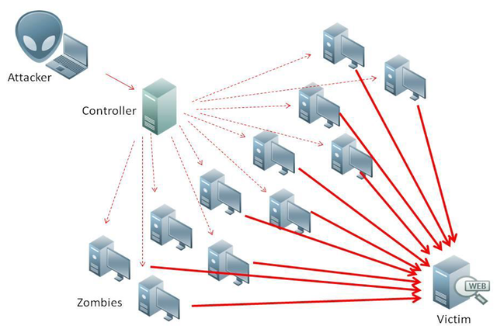
DDOS
Distributed denial of service.
Attack vs Flash crowd.
Strategies at Application layer:
1)Server load.
2)Increasing.
3)Constant.

Slide 3

DDOS
Types of DDOS:
1)Session Flooding Attack.
2)Request flooding Attack.
3)Asymmetric Attack.
4)Slow Request/ Response Attack.

Slide 4

ABSTRACT
Effective Detection of DDOS Attacks.
Detection based on feature selection.
Exploiting Random Forest for computing
feature importance.
SVM used to rescreen the features.
Finally, an optimal feature subset is obtained,
which will reach a higher detection rate and recall
rate.

Slide 5
Existing Techniques and their drawbacks:
CUSUM-based detection technique. (New Ips)
drawback:
1)during flash crowds IP addresses may be new.
2)Attack can be performed with known IP addresses.
Technique based on dynamic statistical properties of the network traffic.
drawback:
1)Change in TTL values always does not effect anomalous traffic.

Slide 6
Limitations of Existing techniques:
Technique based on Distance.
a)Average Distance estimation.
b)distance-based Traffic separation.
Drawback:
1)Distance will not reflect anomaly of traffic.

Slide 7
Proposed Algorithm
RDF-SVM
Combination of RANDOM FOREST and SVM.
Random forest:
Large collection of decorrelated decision trees.
construct multiple decision trees randomly and gains the final classification result by voting.
3) SVM:
mapping data to a high-dimensional feature space.
performs well in generalization and handling with imbalanced dataset.

Slide 8
Advantages
1. Rescreen the features and prevent from deleting the features,
useful for DDOS.
2. DDoS attack traffic Vs Flash Crowd traffic.
3. Suppress the attacks before it reaches.
4. Detect known and unknown attack.

Slide 9
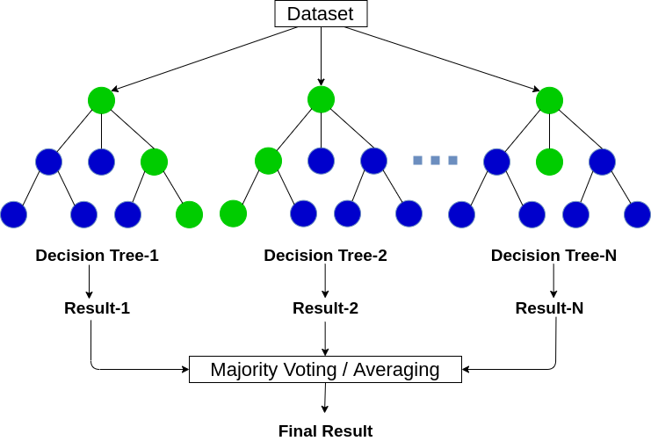
Random Forest

Slide 10


Concept behind importance values
Supervised learning
Measure the disorder of grouping by the target variable
Entropy of the Y given x
Information gain

Slide 11
KDD99 DATASET
Contains 42 features among which last one is the target variable.
Contains 494020 rows.
Need to Preprocess the data
Convert Object data types to integers.
Remove duplicate data.
Normalizing the data.

Slide 12
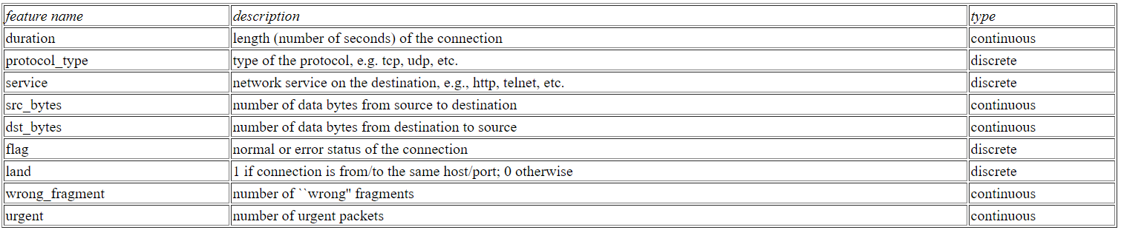
KDD99 DATASET

Slide 13
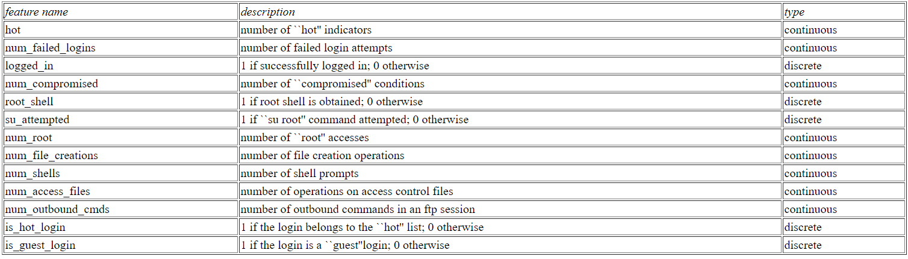
KDD99 DATASET

Slide 14
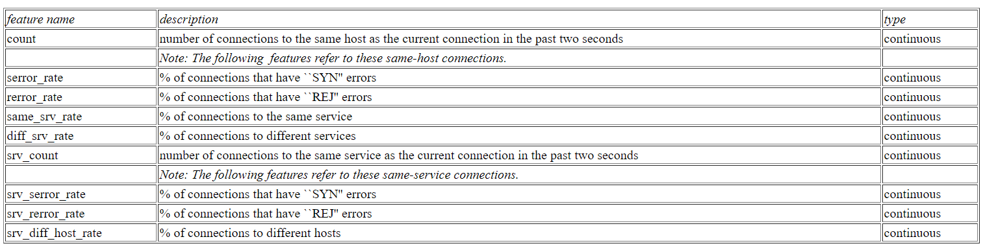
KDD99 DATASET

Slide 15
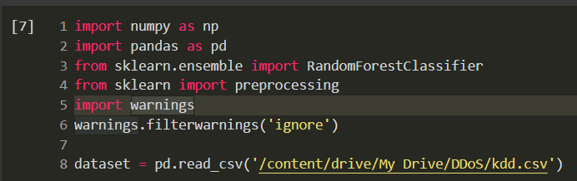
Implementation

Slide 16
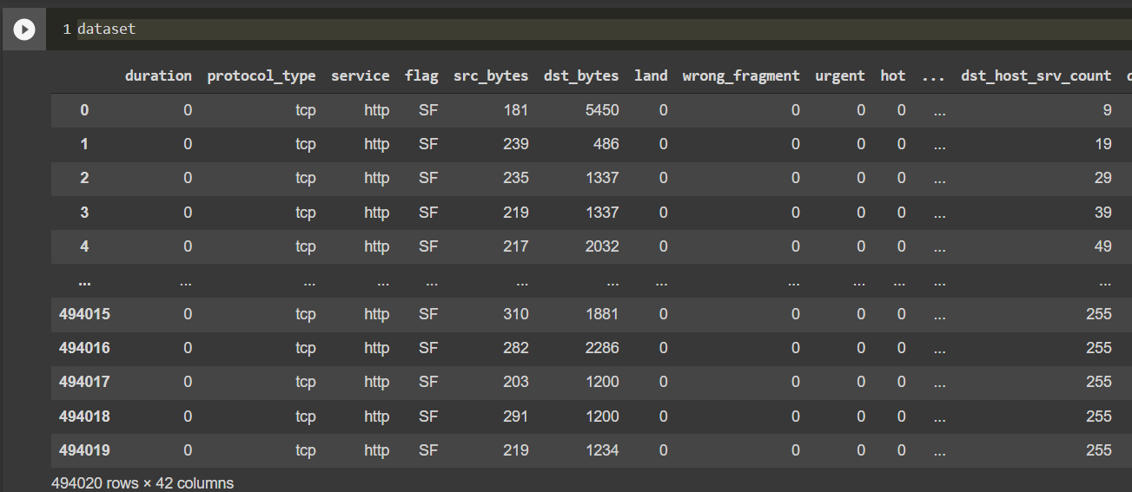
Implementation

Slide 17
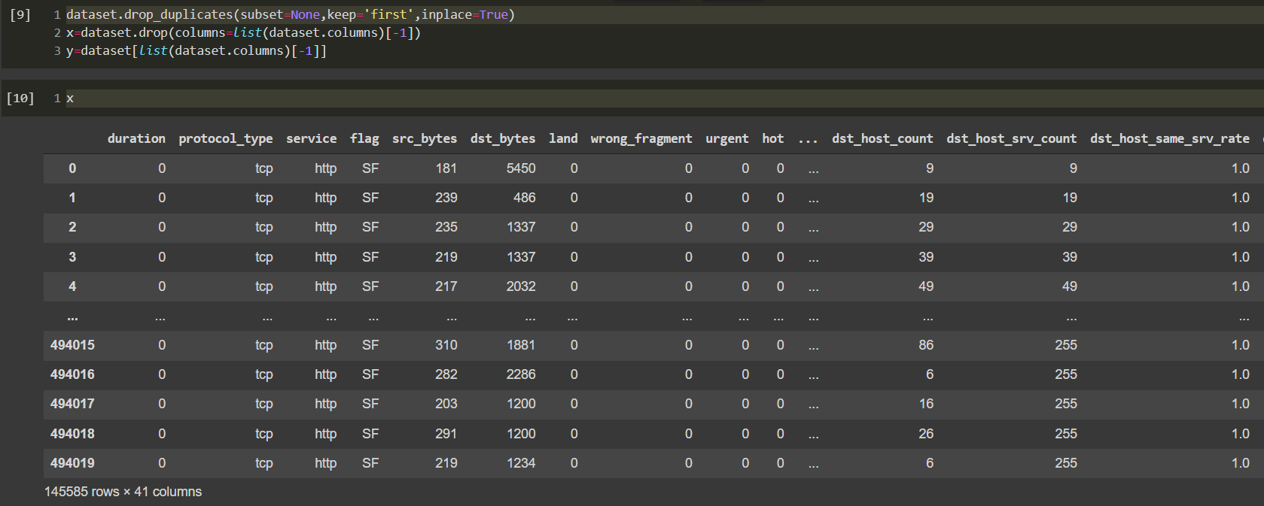
Implementation

Slide 18
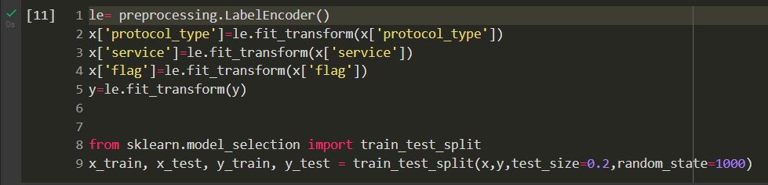
Implementation

Slide 19
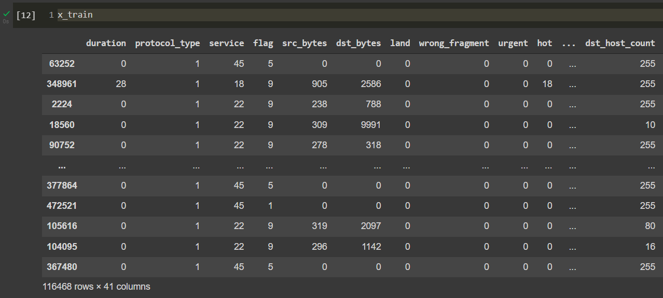
Implementation

Slide 20
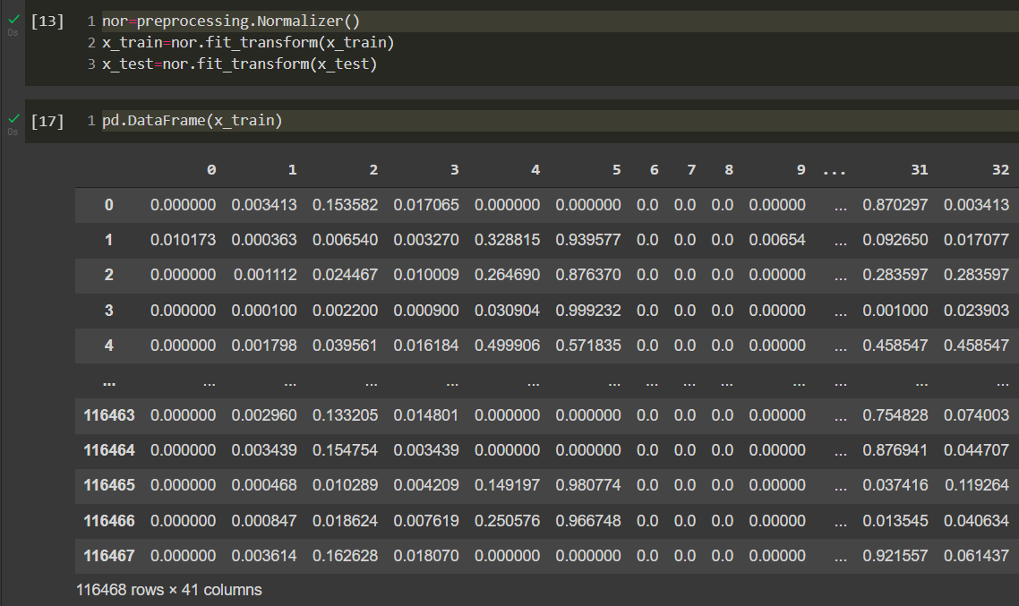
Implementation

Slide 21
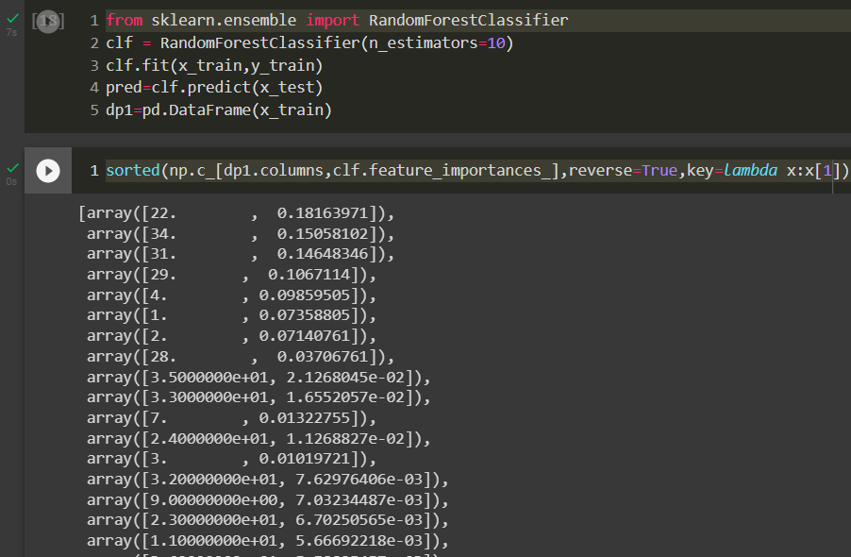
Implementation

Slide 22
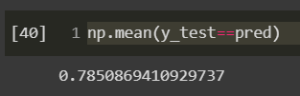
Results
It is the array of (feature, Importance value) values in an descending order of feature importance.
We select the features having the high importance values above the threshold value.
Above is the accuracy of random forest. We need to improve it by rescreening the features with SVM.

Slide 23
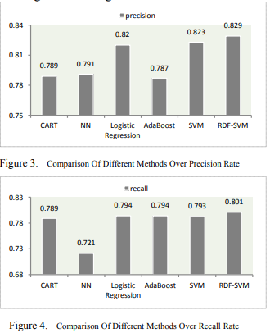
Expected Results
Random forest will select up to 20 features and after rescreening 3 more features will be added to the subset resulting the optimal subset with higher detection and recall rate
The model is compared with different algorithms and show that RDF-SVM gives highest precision and recall.

Slide 24
SUMMARY
Finished
Implemented random forest to compute the importance values.
Unfinished
Need to apply SVM on above selected values to rescreen the features on adding every neglected feature to the set and compute the accuracy.
After applying SVM we get the optimal feature subset which will reach higher detection rate and recall rate.
The model to be compared with different algorithms and show that RDF-SVM gives highest precision and recall.

Slide 25
Thank You

